Slide 3
Money Talk

Slide 4
Everyone Starts as

Slide 5
Customer Benefits

Slide 6
Steps to Becoming a Customer

Slide 7
Associate Benefits

Slide 8
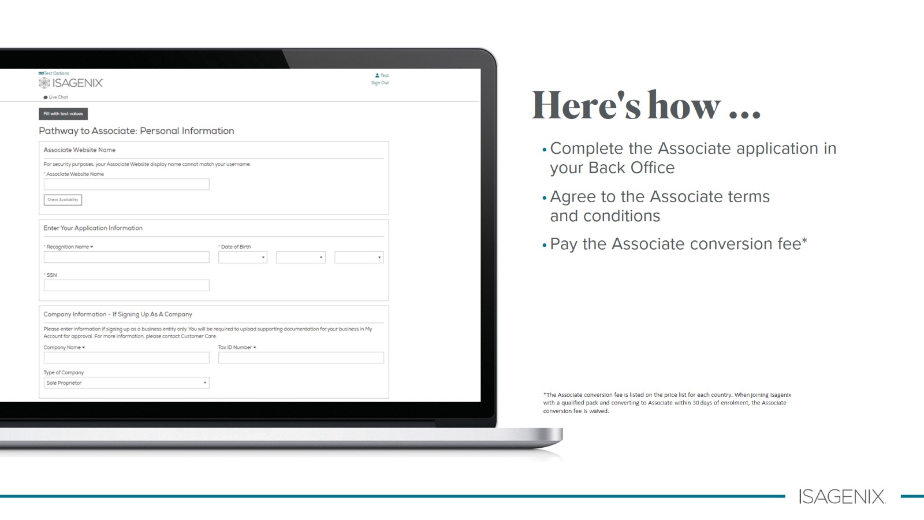
Here's how ...

Slide 9
Key Terms

Slide 10
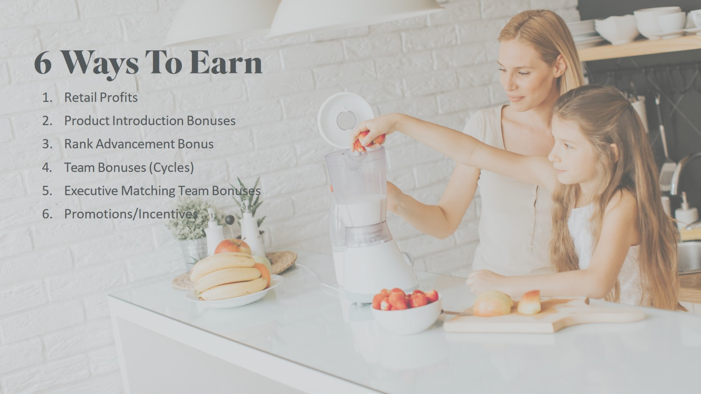
6 Ways To Earn

Slide 11
Retail Profit

Slide 12
Product Introduction Bonus (PIB)

Slide 13
Double Product Introduction Bonus (PIB)

Slide 14
Rank Advancement Bonus (RAB)

Slide 15
Rank Advancement Bonus (RAB)

Slide 16
Consultant

Slide 17
Consultant Benefits

Slide 18
Building Your Teams

Slide 19
Team Bonus (Cycle)

Slide 20
Holdover Volume

Slide 21
Manager

Slide 22
Director

Slide 23
Executive

Slide 24
Executive Benefits

Slide 25
RAB Promotion

Slide 26
Earning Potential with Isagenix

Slide 27
Platinum

Slide 28
What Is Your Time Worth?
There is no security in settling for less than what you really want.

Slide 29
Weekly Pay

Slide 30
Keys to Enjoying the Benefits of the Compensation Plan

